Slide 1




Cryptocurrency
Constantin Ciochina
Wayne Odd
David Allen
Dhruv Patel

Slide 2
Motivation & Summary
Hypothesis: Cryptocurrency is a strong & rapidly growing investment tool
Initial Questions:
How has cryptocurrency fared in popularity and acceptance? Why?
Has crypto been an effective investment tool? Why?
What is the behavior and sentiment behind its users? Why?
Is crypto going to be around a while? Why?
Findings:
Crypto is a strong and rapidly growing investment tool in terms of volume & market cap with profits and losses tied to spikes. There is positive correlation between BTC and altcoins. Crypto continues to rise in popularity and acceptance according to our findings.

Slide 3
Official Questions & Data
Has there been consistent volume in cryptocurrency?
Is there a correlation between BTC and altcoins?
How has cryptocurrency fared in terms of profit / losses for its users?
Can we see any insight on the rate of growth?
Data Needed
Data which incorporates Bitcoin (most widely known and successful coin), other successful coins, and coins that lack utility but maintain notoriety.
Source: Kaggle (Multiple CSV sources) 🡪 Data for various coins 🡪 Timeline extending to beginning stages of crypto 🡪 High, Low, Open, Close, Volume, Market Cap
We chose to narrow this data down to 5 coins, based on time of circulation, Current Marketcap top 10 & popularity.
Bitcoin, Cardano, Dogecoin, Ethereum, Polkadot

Slide 4
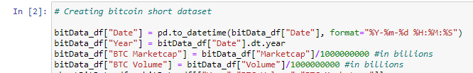
Data Cleanup & Exploration
Our source provided a relatively concise layout of data in which all coins had historical data formatted in the same way. This allowed for a quick initial setup .
Some questions would require all 5 coins to be concatenated to provide a broad level overview going back to 2013. The pd.concat would help us quickly clean the data for this purpose.
Dates required type/format changes to be able to manipulate date by time
Change value data from scientific notation to real numbers

Slide 5
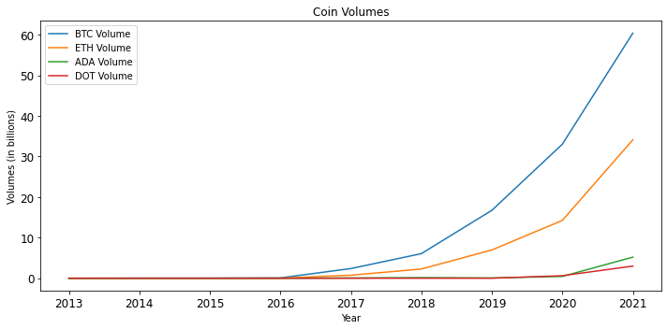
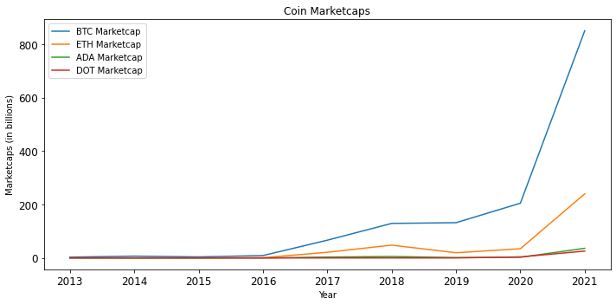
Popularity and Acceptance
Definitions
Marketcap = Total # of coins X Current Market Price per coin
Large cap(>$10B) = lower risk, withstand higher volume volatility
Mid cap($1B - 10B) = untapped potential upside with higher risk
Small cap(<1$B) = most susceptible to market swings
Volume = amount of currency traded during a period,
(prices X purchases)
Coin Information (Established, MarketCap)
Older coins:
BTC (2009, $862B) 13 years
ETH (2014, $376B) 8 years
Popular coin:
DOGE (2013, $37B) 9 years
Newer coins:
DOT (2020, $21B) 2 years
ADA (2017, $58B) 4 years
Comparative Stocks
Tesla: (2003, $700B) 19 years
Netflix: (1997, $226B) 25 years
Square: (2009, $124B) 13 years
notes: lead into correlations

Slide 6
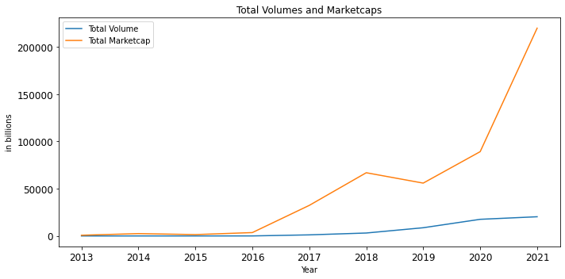
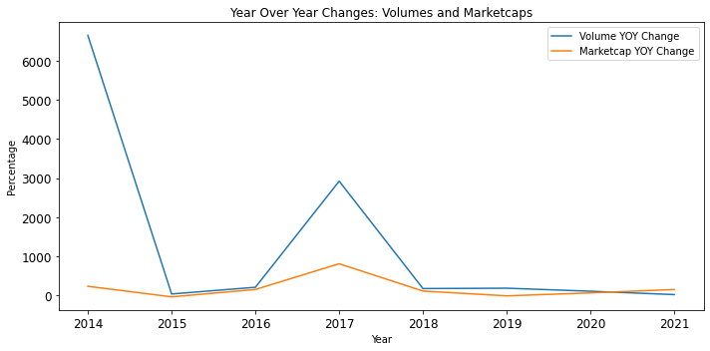
Popularity and Acceptance
Total Volumes and Marketcaps
Steady volume growth = consistent acceptance
Rapid marketcap growth = increased popularity and adoption leading to higher market prices
Similar cycles to stocks/equities, still overall bullish
Year Over Year Growth
Largest Volume adoption changes:
‘13-’14 = 6,652% (9.4 B) initial data
‘16-’17 = 2,920% (1,1151 B)
Largest Marketcap changes:
‘13-’14 = 228% (1,729 B)
‘16-’17 = 805% (28,778 B)
*Lower YOY growth due to market saturation

Slide 7
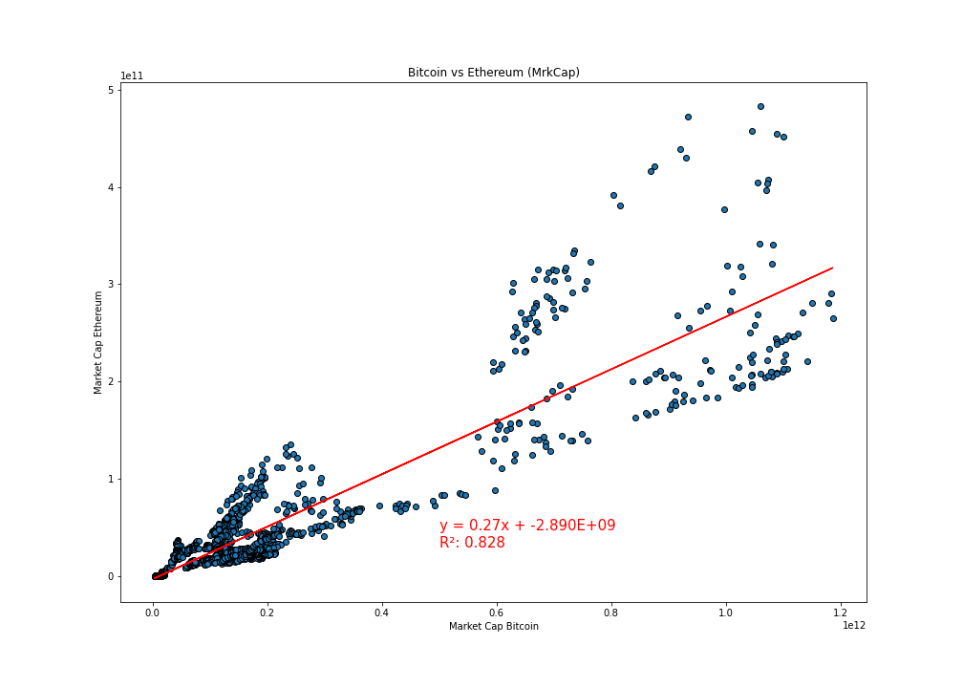
Correlation with BTC
The relation between these two factors, namely the Ethereum MarketCap and the Bitcoin MarketCap, is indicating a strong positive correlation. This high R² value indicates a good model fit., with Ethereum being a good predictor of changes in Bitcoin.
The correlation (r) between both factors is 0.91

Slide 8
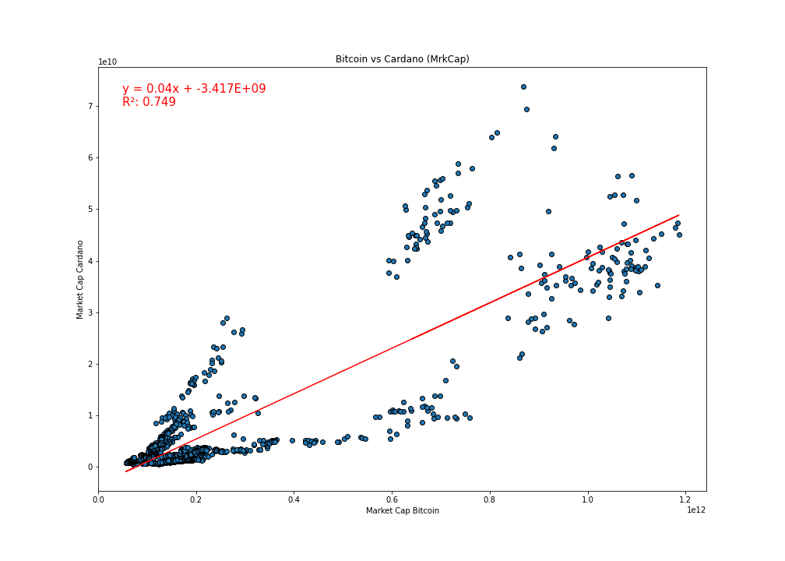
Correlation with BTC
There is a strong positive correlation between the Cardano MarketCap and the Bitcoin MarketCap. R² is indicating that 75% of the variance in the Bitcoin is explain by the regression model. The Cardano is a good predictor of changes in the Bitcoin.
The correlation between both factors is 0.87

Slide 9
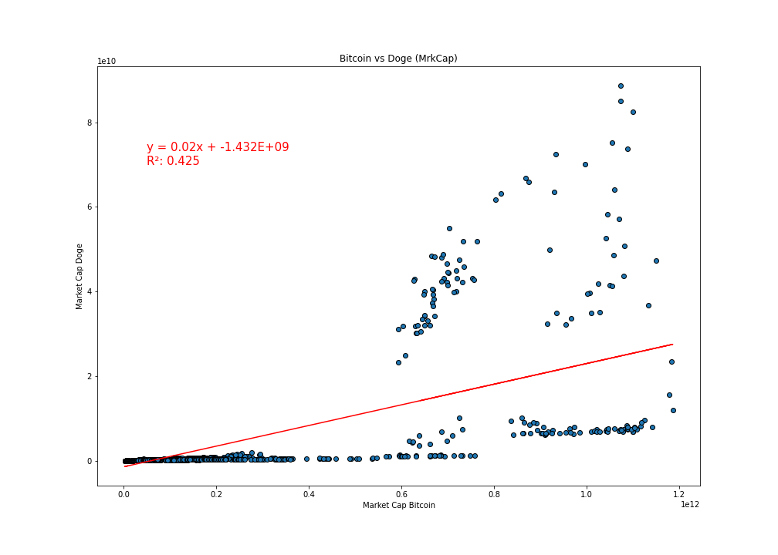
Correlation with BTC
There is a positive correlation between the Doge MarketCap and the Bitcoin MarketCap. This is one of the weakest relationships obtained in my analysis. This mean that Doge Market Capitalization is not a great predictor of the changes in Bitcoin and may be other factors that are better predictors and were not included in the model.
The correlation between both factors is 0.65

Slide 10
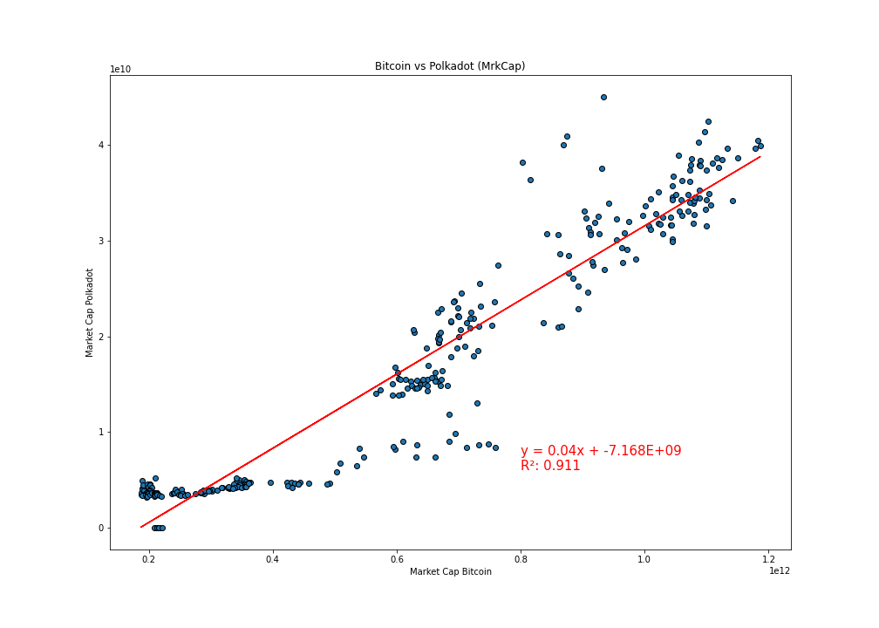
Correlation with BTC
There seems to be a strong positive correlation between the Polkadot MarketCap and the Bitcoin MarketCap. R² is indicating that 91% of the variance in the Bitcoin is explain by the model. This analysis suggest that the best predictor of changes in Bitcoin seems to be Polkadot MarketCap.
The correlation between both factors is 0.95

Slide 11
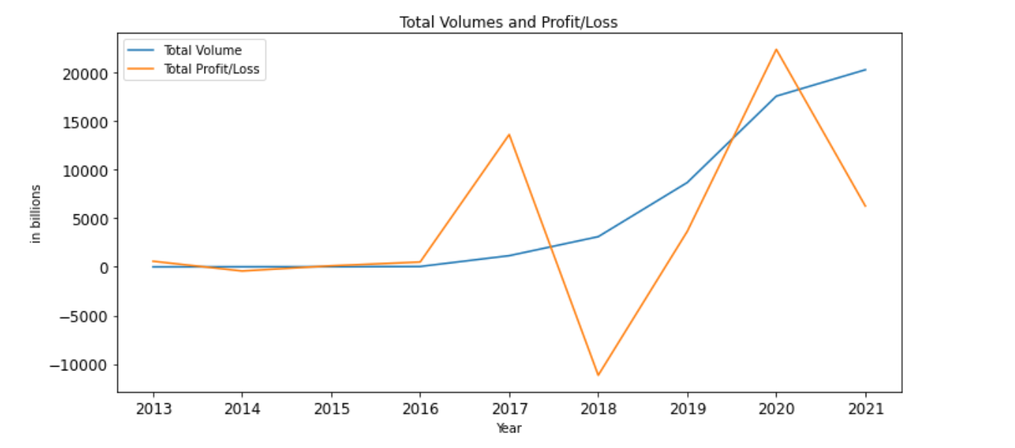
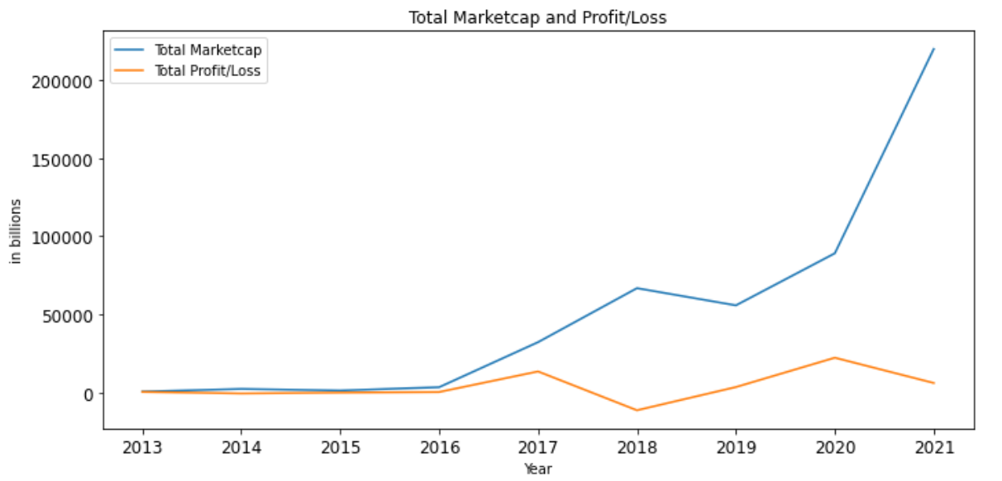
Examining Profits and Losses
When comparing Total Volume to Profit / Loss, we can see that Total Volume has consistently grown since 2013 and Profits have had peaks with Losses thereafter in 2016-2018 and 2020-present.
When comparing Total Marketcap to Profit / Loss, we can see that Total Marketcap has grown almost exponentially since 2013 and Profits have had brief peaks with Losses thereafter in 2016-2018 and 2020-present.
Cryptocurrency tends to bring increased profits THEN losses after each significant rise in volume.
This implies that behavior and sentiment towards cryptocurrency has continued to rise beyond the aspect of profit / loss (hence, more money put in).

Slide 12
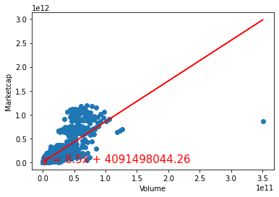
Volume Vs. Market cap
Based upon the R-squared data we can see that the market cap increase has a moderate correlation with the increase in volume.
The r-squared is: 0.6600312227661678
This correlation shows us that as the market capitalization increases, even more transactions occur.

Slide 13
Discussion of Findings
1.Steady volumes and adoption rates leads to exponentially growing marketcaps, leading many of the popular coins to rival many well established companies, like Tesla, Netflix and Square, in a short time frame.
2. All four cryptocurrencies have a positive correlation with Bitcoin. The strongest correlation is with Polkadot, and the weakest with Dogecoin. The Ethereum, Cardano and Polkadot are a good predictor of changes in the Bitcoin.
3. Crypto profits / losses can be associated with spikes in volume and market cap. Buyer sentiment can be associated with a continuously rising market cap.
4. As market capitalization increases, more and more transactions occur.
Conclusions
Cryptocurrencies are still in the early stages with value found in investing
Currently, many of the cryptocoin market is based on the price of Bitcoin as the driving factor
Regardless of the cyclical market, similar to stock exchange, people continue to see the intrinsic value of holding and investing in crypto

Slide 14


Post Mortem
Difficulties
Graphing the wide variances in Marketcaps and Volumes; required value conversions to Billions for larger Marketcap coins
Additional Questions
Can we compare Crypto data with the stock market?
How does profitability/ROI compare?
Which of the two investment tools has seen more growth in volume, market cap, or overall sentiment?
Would our data trends and regression lines look much different if we included the top 25, 50, & 100 coins?
Can we attempt to do a risk analysis of crypto assets?

